Slide 1
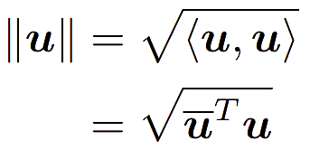
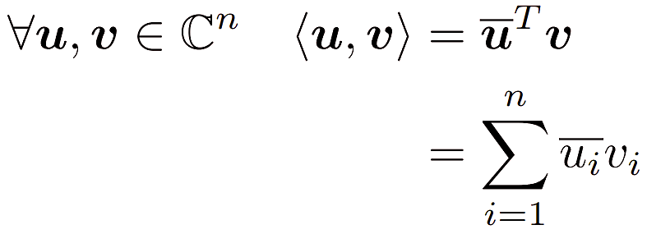
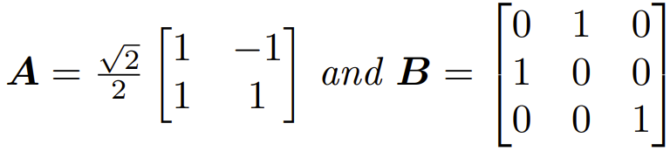



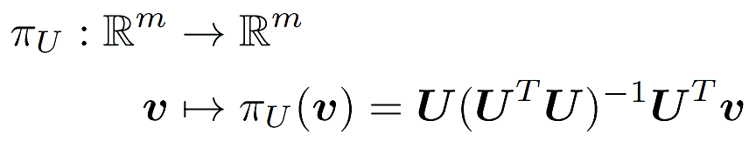
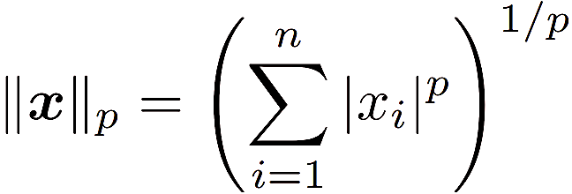
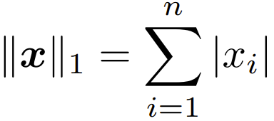
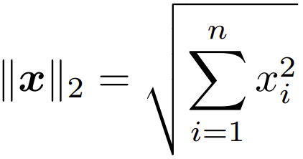
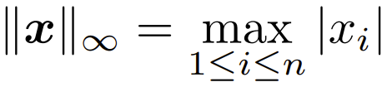


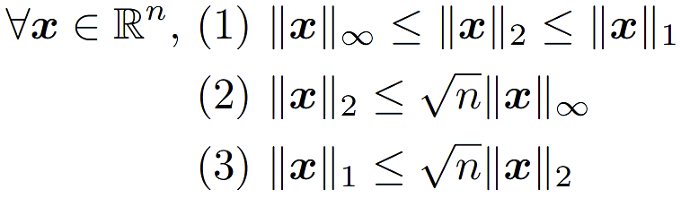

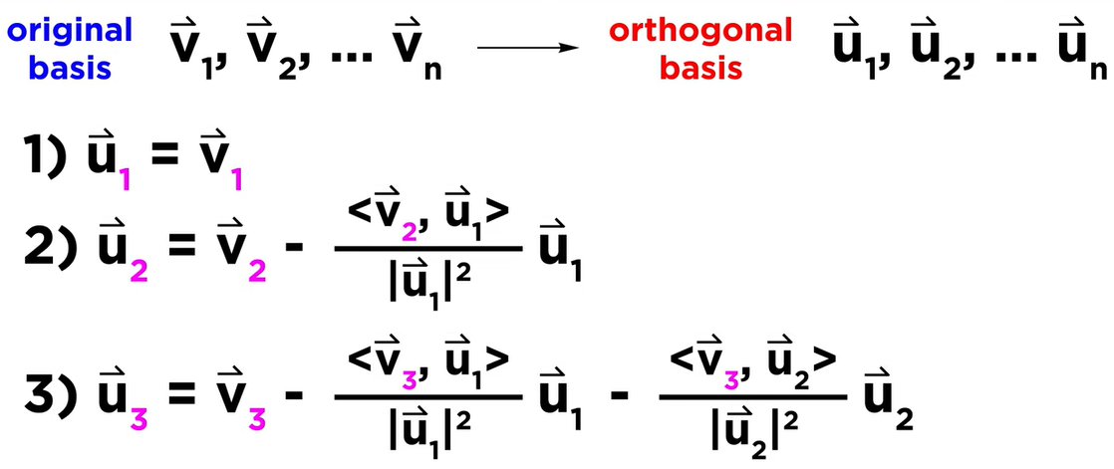
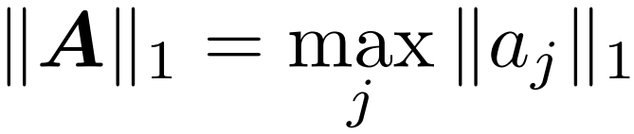
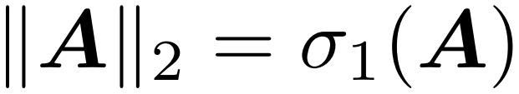
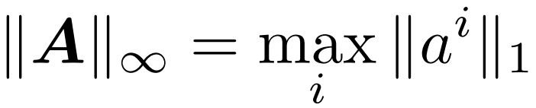
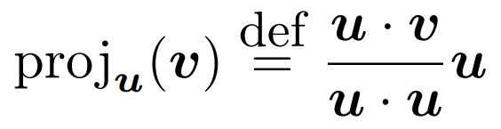

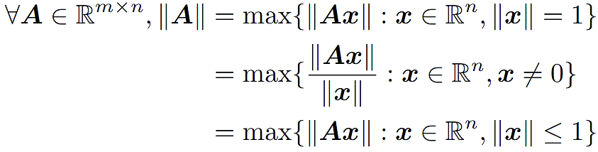
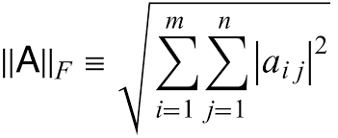

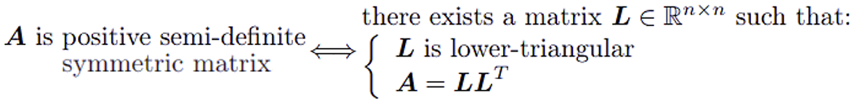



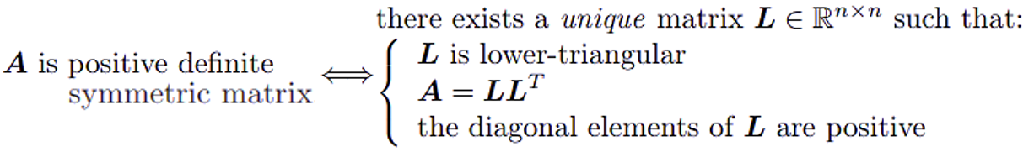

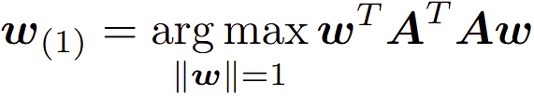
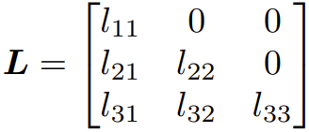
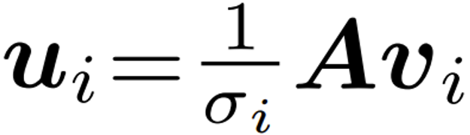
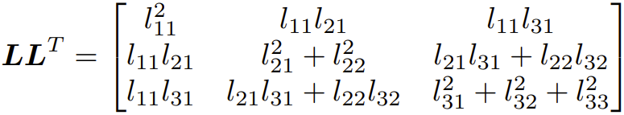
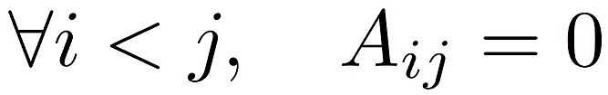


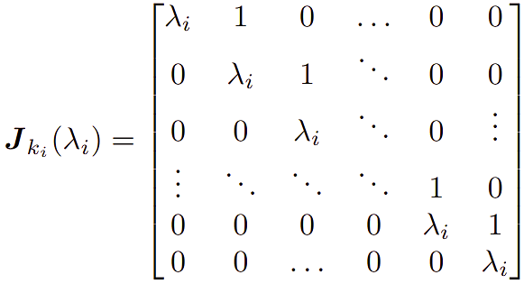
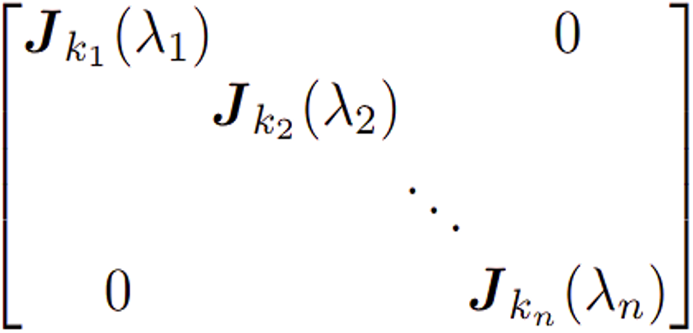
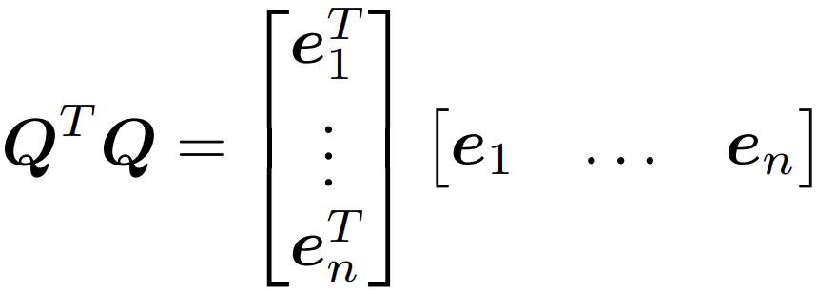

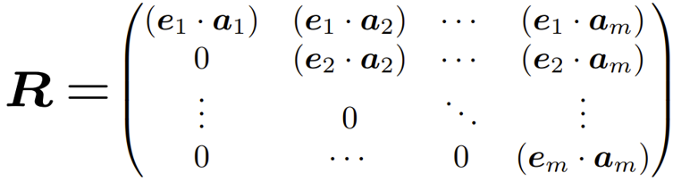
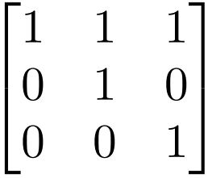
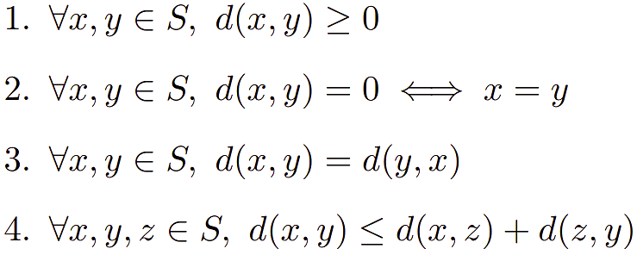
CT
Complex Numbers: zz ∈ R, zz = a² + b² ≥ 0, zz = 0 ⇐⇒ z = 0 Standard Inner Product on C^{n}:
Complex conjugate: z = a + bi → z = a – bi, z = z ⇐⇒ z ∈ R Standard Norm:
Orthogonal Matrix:
Q ∈ R^{n x n} iff Q⁻¹ = Q^{T}
Symmetric Matrices:
A is symmetric if A^{T} = A, and if A ∈ R^{n x n} all eigenvalues λ_{i} of A are real.
All λ_{i} have algebraic multiplicity = geometric multiplicity. All eigenvectors for distinct eigenvalues are orthogonal.
Vector Norms:
Properties:
l_{p}-norm:
+ friends
Equivalence: for r, s > 0, the l_{a} and l_{b} norms are equivalent iff:
Orthogonal Projection on a Subspace:
For A ∈ R^{m x n} all vectors b ∈ R^{m}, there exists a unique b_{i} ∈ im(A), and a unique b_{k} ∈ ker(A^{T}) such that b = b_{i} + b_{k}.
Orthogonal transformations preserve the Euclidian length of any vector, and the magnitude of the angle between any two vectors:
det Q = 1 or -1, for all eigvals λ_{i}, |λ_{i}| = 1
l₁, l₂, and l∞ norms are equivalent
Spectral Theorem:
For symmetric A ∈ R^{n x n}, A can be diagonalised as A = QDQ^{T} = QDQ⁻¹ where Q is orthogonal and D is a diagonal matrix where the diagonal elements are A’s eigenvalues.
1. Roots of det (A – λI) (eigenvalues (λ_{i})_{1≤i})
2. For each λ_{i} find the corresponding eigenspace (sub into A – λI and solve = 0)
3. Make orthonormal (magnitude 1, and may need gram-schmidt)
4. Combine bases to form Q
5. Write associated eigenvalues for cols of Q in order to form D
Matrix Norms:
Properties: same as above +
Norms:
Matrix norm || . || on R^{m x n} is consistent with the vector norms || . ||_{a} on R^{n} and || . ||_{b} on R^{m} if ∀ A ∈ R^{m x n}, x ∈ R^{n}:
if a = b, || . || compatible with || . ||_{a}
Subordinate Matrix Norm:
For p = 1, 2, ∞, matrix norm || . ||_{p} is
subordinate and compatible with vector norm || . ||_{p}
Least Square Method + Linear Regression:
If Ax = b has no solution we attempt to minimise ||Ax – b||₂².
Normal Equation: A^{T}Ax = A^{T}b gives solution to the least square problem.
Finding s₀ ∈ R and s ∈ R^{n} minimising the sum of errors between the model predictions s₀ + s · a_{i} and observations y_{i}, can be done by finding the z = [s₀ … s_{n}]^{T} minimising ||Az − y||₂², i.e. by solving the normal equation A^{T}Az = A^{T}y.
Gram-Schmidt Bullshit:
<v, u> = v . u (see above for complex version)
largest of abs sum of cols
largest singular value of A
largest of abs sum of rows
Frobenius Norm
Positive (Semi-)Definite Matrices:
Definite iff
- all eigenvalues strictly positive
- all diagonal elements strictly positive
-
Semi iff
- all eigenvalues are non-negative
- all diagonal elements non-negative
-
Largest coefficient of A on diagonal for both definite and semi-definite
Negative equivalents with flipped signs
For matrix A, A^{T}A and AA^{T} are both symmetric and positive semi-definite
Cholesky Decomposition <3:
A = LL^{T}
A must be positive (semi-)definite and symmetric
Solve A = LL^{T}
Singular Value Decomposition:
A = USV^{T}
1. Find eigenvalues of AA^{T} (these form matrix S which has the same dimensions as A and descending sqrt of eigenvalues in the diagonal)
2. Find orthonormal set of vectors of A^{T}A (these are the columns of V – remember the final product uses V^{T}!!)
3. Find columns of U using formula for 1 ≤ i ≤ rank(A) – remember the V_{i} come from V not V^{T}!! To extend U to enough cols pick v_{j} which are perp to lin comb of existing v_{i} and G-S.
Mat Dims: A: n x m, U: n x n, S: n x m, V^{T}: m x m
Properties:
rank(A) = no. +ve singular values in S
The positive singular values of A are the square roots of the eigenvalues of AA^{T} or A^{T}A
Orthonormal Basis for im(A): span of the first rank(A) columns of U
Orthonormal Basis for ker(A): span of remaining columns of V after taking out first rank(A) cols
Principal Component Analysis:
A ∈ R^{m x n} = m samples of n dimensional data
A = USV^{T} - principal axes of A = columns of V
- principal components of A = columns of US
Both over 1 ≤ i ≤ rank(A)
First principal axis:
Given
we see the relation between A and the principal components and axes. If σ₁ >> σ₂, the data in A can be compressed by projecting in the direction of the principal component:
This is sometimes used in data compression, PCA, and dimensionality reduction algorithms
Lower triangular iff
Upper triangular iff
QR Decomposition (Gram-Shit):
A = QR
A = [a₁, …, a_{n}], assuming a₁, …, a_{n} are linearly independent
1. Use Gram-Schmidt to construct an orthonormal basis (e₁, …, e_{n}) s.t.
span {e₁, …, e_{n}} = span {a₁, …, a_{n}}
2. Q = [e₁, …, e_{n}]. Note Q is semi-orthogonal:
3. Choose
Householder Map:
For hyper-plane P going through the origin with unit normal u ∈ R^{m}, i.e.,
P = {x ∈ R m : u · x = 0} the Householder matrix defined by H_{u} = I − 2uu^{T} induces reflection wrt P.
Properties:
- H_{u} is involutory: H_{u} = H_{u}⁻¹
- H_{u} is orthogonal: H_{u}^{T} = H_{u}⁻¹
- H_{u} preserves the Euclidian length of vectors: ||H_{u}(x)|| = ||x||
- H_{u} preserves angles between vectors
- All rotations and reflections are orthogonal operations
- Orthogonal projection Q on the hyperplane P is given by: Q = I − uu^{T} with Q² = Q and Q = Q^{T}
Jordan Normal Form:
Note: The algebraic multiplicity of an eigenvalue λ is the sum of the sizes of blocks with λ on the diagonal. The geometric multiplicity of λ is the number of blocks with λ on the diagonal.
1. Find eigenvalues of A (note the a_{i} of each λ)
2. Find eigenspaces for each (note g_{i} of each E_{λi})
3. If g_{i} < a_{i} find missing a_{i} – g_{i} generalised eigenvectors
4. Put eigenvectors in order into matrix (change of basis matrix B)
5. J = B⁻¹AB
Generalised Eigenvalues:
Given square A ∈ R^{n x n} a non-zero vector v ∈ C^{n} is a generalised eigenvector of rank m associated with eigenvalue λ ∈ C for A if:
Thus, any eigenvector associated with λ is itself a generalised eigenvector of rank 1.
The image of a vector of the eigenspace
- Associated to λ through A − λI is 0.
- of rank 1 (if there are some) through A −λI is in the eigenspace associated to λ.
- of rank 2 (if there are some) through A−λI is in the vector space generated by the generalised eigenvector of rank 1.
- and so forth...
Generalised EVs Associated with λ:
A ∈ R^{n x n} with eigenvalue λ ∈ C of algebraic multiplicity k, there are k linearly independent generalised eigenvectors v ∈ C^{n} associated with λ. It includes the eigenvectors associated with λ, as they are generalised eigenvectors.
Number of Generalised Eigenvectors:
A ∈ R^{n x n} has n linearly independent generalised eigenvectors. There exist a basis of C^{n} of generalised eigenvectors of A.
Example:
For matrix A defined as:
we have det(A − λI) = (1 − λ)³ which gives λ₁ = 1 and 2 linearly independent EVs v₁ = (0, 1, −1)^{T},
v₂ = (1, 0, 0)^{T} but since λ₁ has algebraic multiplicity of 3 we find v₃ using (A − λ₁I)v₃ = v₂ which gives v₃ = (0, 0, 1)^{T}. We use v₂ here as it is in the row space (a multiple of it is a row of A) so v₃ will be linearly independent.
Convergence of QR in A = LU Case:
Non-singular matrix A can be factorised as
QR Algorithm:
Used to find eigenvalues of matrices, works for most matrices. Consider sequence A_{k} defined below:
A₀ = A
For k ∈ N apply the QR decomposition to
A_{k}: A_{k} = Q_{k + 1}R_{k + 1}
Stop after sufficient iterations
Properties: (note Q~ is Q with ~ on top denoting orthogonality of Q)
For k ∈ N, A_{k} is similar to A. A_{k} = Q˜_{k}^{T} AQ˜_{k} so A_{k} and A have the same eigenvalues and v is an eigenvector of A_{k} iff Q˜_{k}v is an eigenvector of A. The sequence A_{k} converges to an upper triangular matrix under certain conditions. The eigenvalues of an upper triangular matrix are the diagonal elements.
Symmetric A: All A_{k} are symmetric. For large enough k, the columns of Q~_{k} are in effect the eigenvectors of A.
A = LU where L is lower triangular and U upper, iff A can be reduced to REF without swapping any rows. Transform A into REF to get U, then we know L⁻¹A = U so can find L.
Uniqueness: A = LU is only unique iff A is non singular and the diagonal elements of L are all 1.
A^{n} = Q₁ … Q_{n}R₁ … R_{n}
Convergence: Let A ∈ R^{n x n} be a symmetric positive definite matrix with distinct eigenvalues λ₁ > λ₂ > . . . > λ_{n} > 0 with eigendecomposition A = QΛQ^{T}. Suppose Q^{T} = LU with unit lower triangular L and the diagonal elements of U are positive. Then A_{k} → Λ
Convergence:
Convergence of real numbers:
lim_{n → ∞} a_{n} = l iff
1. Find limit l
2. Take ε > 0
3. Put |a_{n} – l| < ε, find expression for n > … and set N = roof of what n is >
Cauchy Sequence:
(terms get gradually closer). a_{n} is only convergent if it is Cauchy.
Metric Spaces:
A tuple (S, d) where S is a non-empty set and d is a metric over S (d : S x S → R).
Prove the below properties hold to show we have a metric space:
Convergence in a Metric Space:
Space = (S, d), sequence = a_{n}, limit = l ∈ S
a_{n} converges to l iff:
If a_{n} converges it’s limit is unique.
Cauchy Seq. (Metric Spaces):
For (S, d) and a_{n} a sequence in S, a_{n} is only convergent if it is Cauchy.
Complete Spaces:
Metric space (S, d) is a complete space iff every Cauchy sequence in S is also converging in S. For any k > 0, R_{k} equipped with any of the three metrics induced by l₁, l₂ or l∞ norms is complete.
Fixed Point Equations:
For non-empty set S and f: S → S, p ∈ S is called a fixed point if f(p) = p. E.g. for f(x) = x², f(p) = p for p = 0, 1:
Contraction:
For metric space (S, d) and f : S → S, f is called a contraction of S (or a contracting map) if there exists
0 ≤ α < 1 called the contraction constant such that:
Fixed Point Theorem:
Let (S, d) be a complete metric space and f a contraction of S. Then f has a unique fixed point.
Applications: Newton’s Method and Initial Value Problem for differential equations.

Slide 2
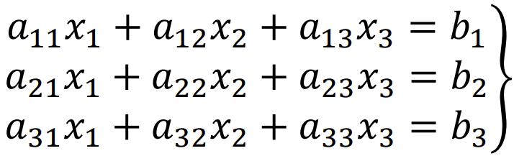
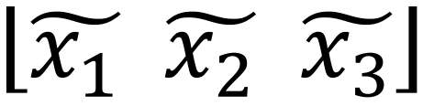
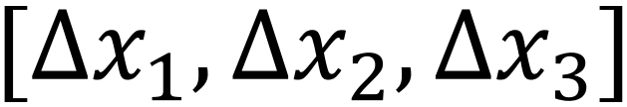
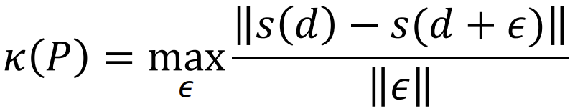
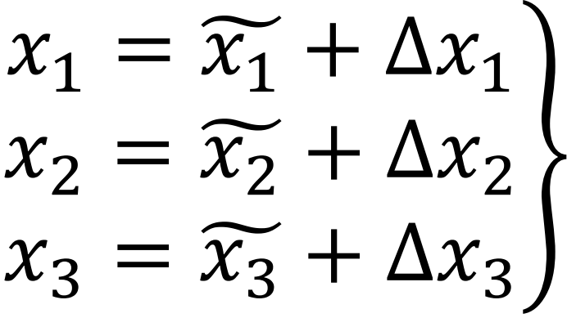
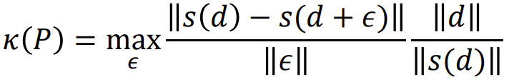

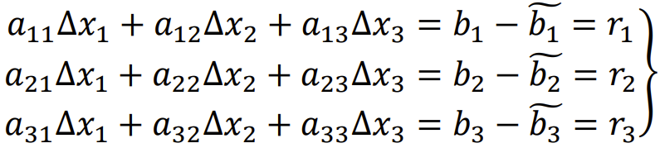
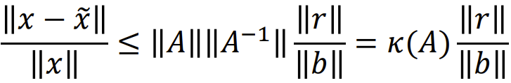
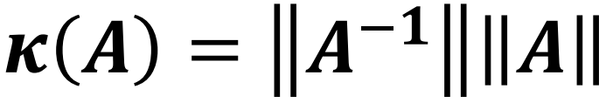

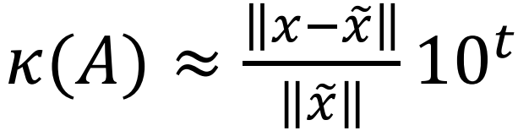
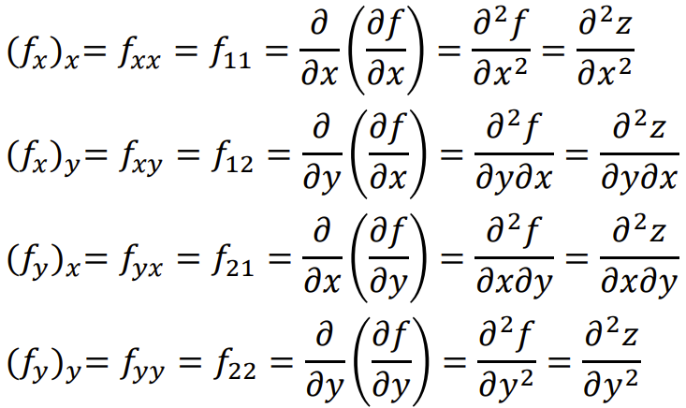
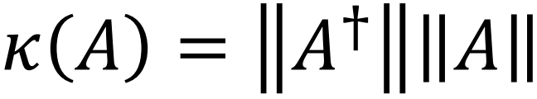
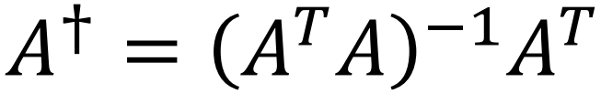


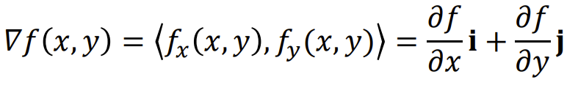
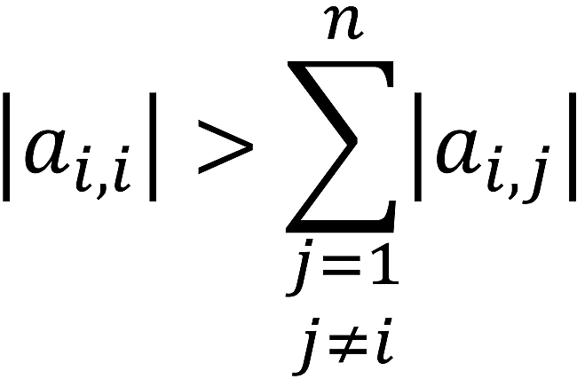



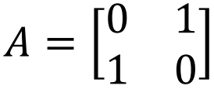
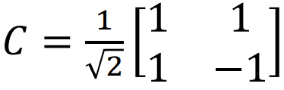
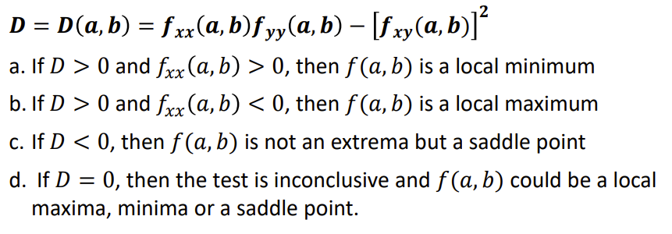
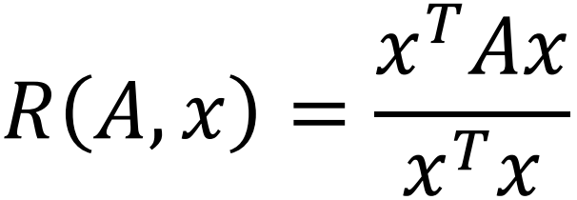
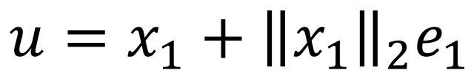
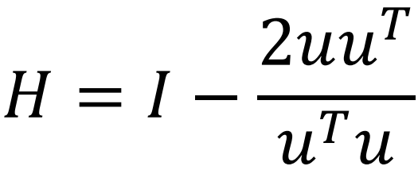
































Condition Number:
Measure of sensibility of a problem to small fluctuations in input.
Stability of the System: how the system responds to noise in input
Sensibility of Solution: how small changes in parameters affect the solution of a parametric equation
Let P = problem of interest, d = input, ε = perturbation in input, s(d) = desired output, s(d + ε) = perturbed output.
Relative Condition Number:
Value depends on the norms being used. Can also be defined in terms of relative difference.
Unstable system/Ill-conditioned problem: large condition number
(cannot always assume ill-conditioned for matrices though!!)
Stable system/Well-conditioned problem: small condition number
Condition Number for Square Non-Singular Matrices:
Gives a bound on the relative change on A⁻¹ given by perturbation on A.
Pseudo-Inverse and Condition Number:
Not all matrices can be inverted hence k(A) cannot be calculated. We can instead use the pseudo-inverse and define a generalisation of the above formula for k(A):
A^{T}A is square, then Ax = b → A^{T}Ax = A^{T}b → x = (A^{T}A)⁻¹A^{T}b
Conditioning of a Problem:
T-Digit Arithmetic:
Rule of thumb: for condition number k(A) you lose about c = log₁₀ k(A) significant figures in accuracy
Error Bounds and Iterative Refinement:
When solving Ax = b, with approximate solution x~, using the residual vector ||r|| = ||b = Ax~|| or other geometric measures may not always be good ways to measure how good an estimate x~ is. The norms of A and A⁻¹ may provide useful information on error bounds through the following theorem:
Suppose that x~ is an approximation to the solution of Ax = b, and A is a non-singular matrix and r is the residual vector of x~. Then for any natural norm
Bbbbbbbbbbbbbbbbbband if x ≠ 0 and b ≠ 0,
E.g. for A we have ||A||∞ = 3.0001, ||A⁻¹||∞ = 20000, and k(A) = ||A||∞||A⁻¹||∞ = 60002 – the size of the condition number should keep us away from making hasty decisions on accuracy.
Iterative Refinement:
Solving Ax = b numerically you get x~, with the residual vector defined as r = b – Ax~ being a reliable indicator of accuracy iff A is well-conditioned. Iterative refinement aims to reduce round-off errors. Suppose we are solving: Approx sol:
Correction factors:
Where:
We sub the formulae of x₁, x₂, and x₃
into the above, then subtract the subbing
in of x~ as the solution to obtain:
We solve to obtain
new correction
factors to improve
the solution of x_{i}.
With t-digit arithmetic and Gaussian Elimination, one can expect
Bbbbbbbbbbbbbbbb and one can show that the approximation to the condition number is:
Functions of Several Variables:
Clairaut’s Theorem:
bbbbbbbbbbf_{xy}(a, b) = f_{yx}(a, b)
Directional Derivatives:
If f is a differentiable function of
x and y then f has a directional
derivative in the direction of unit
vector u = <a, b>: D_{u}f(x, y) = f_{x}(x, y)a + f_{y}(x, y)b. For unit vector at angle θ use <a, b> = <cos θ, sin θ> (maximised at θ = 0). D_{u} represents the rate of change of z in the direction of u. Can also be written as: ,
Directional derivative = scalar proj of gradient vec onto u (make u a unit vector first).
Tangent Plane and Normal Line to Level Surface:
If 𝛻𝐹(𝑥₀, 𝑦₀, 𝑧₀) ≠ 𝟎, it is natural to define the tangent plane to the level surface 𝐹(𝑥, 𝑦, 𝑧) = 𝑘 at 𝑃(𝑥₀, 𝑦₀, 𝑧₀) as the plane that passes through P and has normal vector 𝛻𝐹(𝑥₀, 𝑦₀, 𝑧₀). 𝛻𝐹(𝑥₀, 𝑦₀, 𝑧₀) gives the direction of fastest increase of f.
Maxima and Minima:
Local max: at (a, b) if f(x, y) ≤ f(a, b) for all points (x, y) in some disk with centre (a, b). Similar for local min and global max/min if inequalities hold for all (x, y). f_{x}(a, b) = 0 and f_{y}(a, b) = 0 (𝜵𝒇(𝒂, 𝒃) = 0). Critical point if prev condition or one does not exist.
Second Derivatives Test:
Hessian Matrix:
2nd derivative test generalizes to test based on eigenvalues of D (+ve = min, -ve = max, mix = saddle, singular D = inconclusive).
Iterative Techniques for Eigenvalues and Eigenvectors:
Power Method/Power Iteration:
Take initial vector x₀ = [1, 1, 1, 1]^{T}. Converges to the eigenvalue with largest modulus.
Limitations: If not all eigenvalues have distinct modulus, will return linear combination of the corresponding EVs. Convergence slow if dominant eigenvector not very dominant.
Inverse Power Iteration: Do the above on A⁻¹ to get 1/𝜆 where 𝜆 is the EV with smallest modulus of A.
Shifts: A – sI
𝜆 ∈ R is an eigenvalue of matrix A iff (𝜆 − 𝑠) is an eigenvalue of matrix A − sI. If {𝜆, v} is an eigenpair of A and s ≠ 𝜆 then {1/(𝜆 – s), v} is an eigenpair of (A – sI)⁻¹. Allows us to focus on other eigenvalues.
Method: choose s such that 𝜇₁ = 1/(𝜆_{j} − s) is the dominant eigenvalue of (A – sI)⁻¹. The eigenvalue of interest for A is given by : 𝜆_{j} = 1/𝜇₁ + s. If the eigenvector oscillates, 1/𝜇₁ should be negative.
Rayleigh Quotient:
While using an iterative technique, can use Rayleigh Quotient to monitor convergence to eigenvalue directly, not it’s modulus:
Deflation:
Find second dominant eigenvalue by deflating A to
B ∈ R^{(n – 1) x (n – 1)} which has all eigenvalues of A except dominant one.
Steps: find , do , then
Bbbbbbbbbbbbbbbbb (remember H⁻¹ = H)
Then can use B to get 𝜆₂
Iterative Solutions of Linear Equations:
Jacobi: each stage uses the previous stage’s results
Gauss-Seidel: each stage uses most recent values
G-S Convergence: For Ax = b, converges if
Simultaneous equations
u(x₁, x₂) and v(x₁, x₂) converge if:
Prove G-S convergence using 2x2 general A and b
Splitting – General Method:
A = G + R, then solve x_{k + 1} = Mx_{k} + c. For consistent norm ||.|| on R^{n x n} if ||M|| < 1 the sequence converges for any starting point x₀.
Rate of convergence r ∝ − log₁₀ ||M||
Note about non-diagonal matrices:
For a matrix like with all diagonal elements 0, we cannot split it so we use a change of basis (C = C⁻¹):
By denoting C⁻¹AC = B, C⁻¹x = y, and C⁻¹b = c we solve By = c and can retrieve x through x = Cy.
Jacobi Method:
A = D + R where R = L + U (D = diags, L = lower tri, U = upper tri)
M = -D⁻¹R and c = D⁻¹b
Gauss-Seidel Method:
A = (D + L) + U, M = -(D + L)⁻¹U, c = (D + L)⁻¹b
Condition Number and Convergence:
For Ax = b if the condition number of A is large J and G-S converge more slowly/not at all
If A is weakly row diagonally dominant and irreducible, J and G-S both converge (G-S faster)
Linear Programming:
Graphical Method:
Draw lines, shade exclusion zones, rearrange objective function for y, move line until maximised, sub for P.
Simplex Method: (stop when no more –ve in z row)
1. Most negative value in z row (highlight col)
2. Ratios (sol / col), highlight lowest ratio’s row
3. Replace row var (basic) with highlighted col var (non-basic)
4. Make pivot = 1 (divide highlighted row by cross highlighted value
5. Gaussian elimination to clear rest of highlighted col
Diagonally Dominant Matrix:
A ∈ R^{n x n} is strictly row diagonally dominant if:
A is non-singular.
Let A ∈ R^{n x n} and 𝜌(A) = max_{𝜆 ∈ Sp(A)} |𝜆|be the spectral radius of A. For 𝜖 > 0, there exists an induced norm such that ||A|| < 𝜌(A) + 𝜖.
Irreducible Matrix:
If A (an n x n matrix) cannot take the form through symmetric permutation of its rows and columns, where A₁₁ etc are square block matrices and P is a permutation matrix.
Permutation Matrix:
Square matrix with all elements 0 except exactly one 1 in each row/column. P^{T}P = PP^{T} = I.
Checking Irreducibility with Graph:
If a_{ij} where , i ≠ j, draw an arrow from point i to j.
Irreducible iff from any point you can go to any other
point by following arrows.
Given graph is for a 4x4 reducible matrix.
1
4
2
5
Conjugate Gradient Method:
Ax = b, for A ∈ R^{n x n} converge in n steps
Larger condition number = slower convergence
Check convergence by size of norm of residual
3
Solution:
x₁ = 4, x₂ = 0, x₃ = 3, z = 38
When x_{n} not in z col, x_{n} = 0.
Dual LP Problem:
Every minimisation/maximisation has a dual problem which aims to max/min based on the same constraints. When both are optimised they are equal. Sometimes the dual is easier to solve than the primal.
Gradient Based Optimisation:
Quadratic Form:
For symmetric A:
Gradient/Steepest Descent: Finds local minimum
Gradient: where 𝛼 is a fixed step size
Find 𝛼:
Sub x₁ into f(x) and solve d/dh = 0 to get optimal h (= 𝛼)
Steepest: ,
For quadratic function ,
where
Remember works in orthogonal steps, so (x² – x¹) . (x³ – x²) = 0
Gradient Ascent: Finds local maximum
Common Stopping Criteria:
Gradient close enough to 0
Improvements in function value are saturating
Movement between iterates small enough
Relative measure (no dependence on scale of f)
Another relative measure
Algorithm for Solving System of Linear Equations:
Note that x = x + 𝛼r
r (residual) = b – Ax
= b – A(x + 𝛼r) = r - 𝛼Ar
Slow convergence hence not
widely used for linear equs –
used for non-linear equs tho
Then solve maximisation problem and get the same result :)
←Exact line search
Alt: choose const, diminishing step size (1/k)

